Slide 1


RESULTS OF POST-MERGER INTEGRATION SURVEY

Slide 2
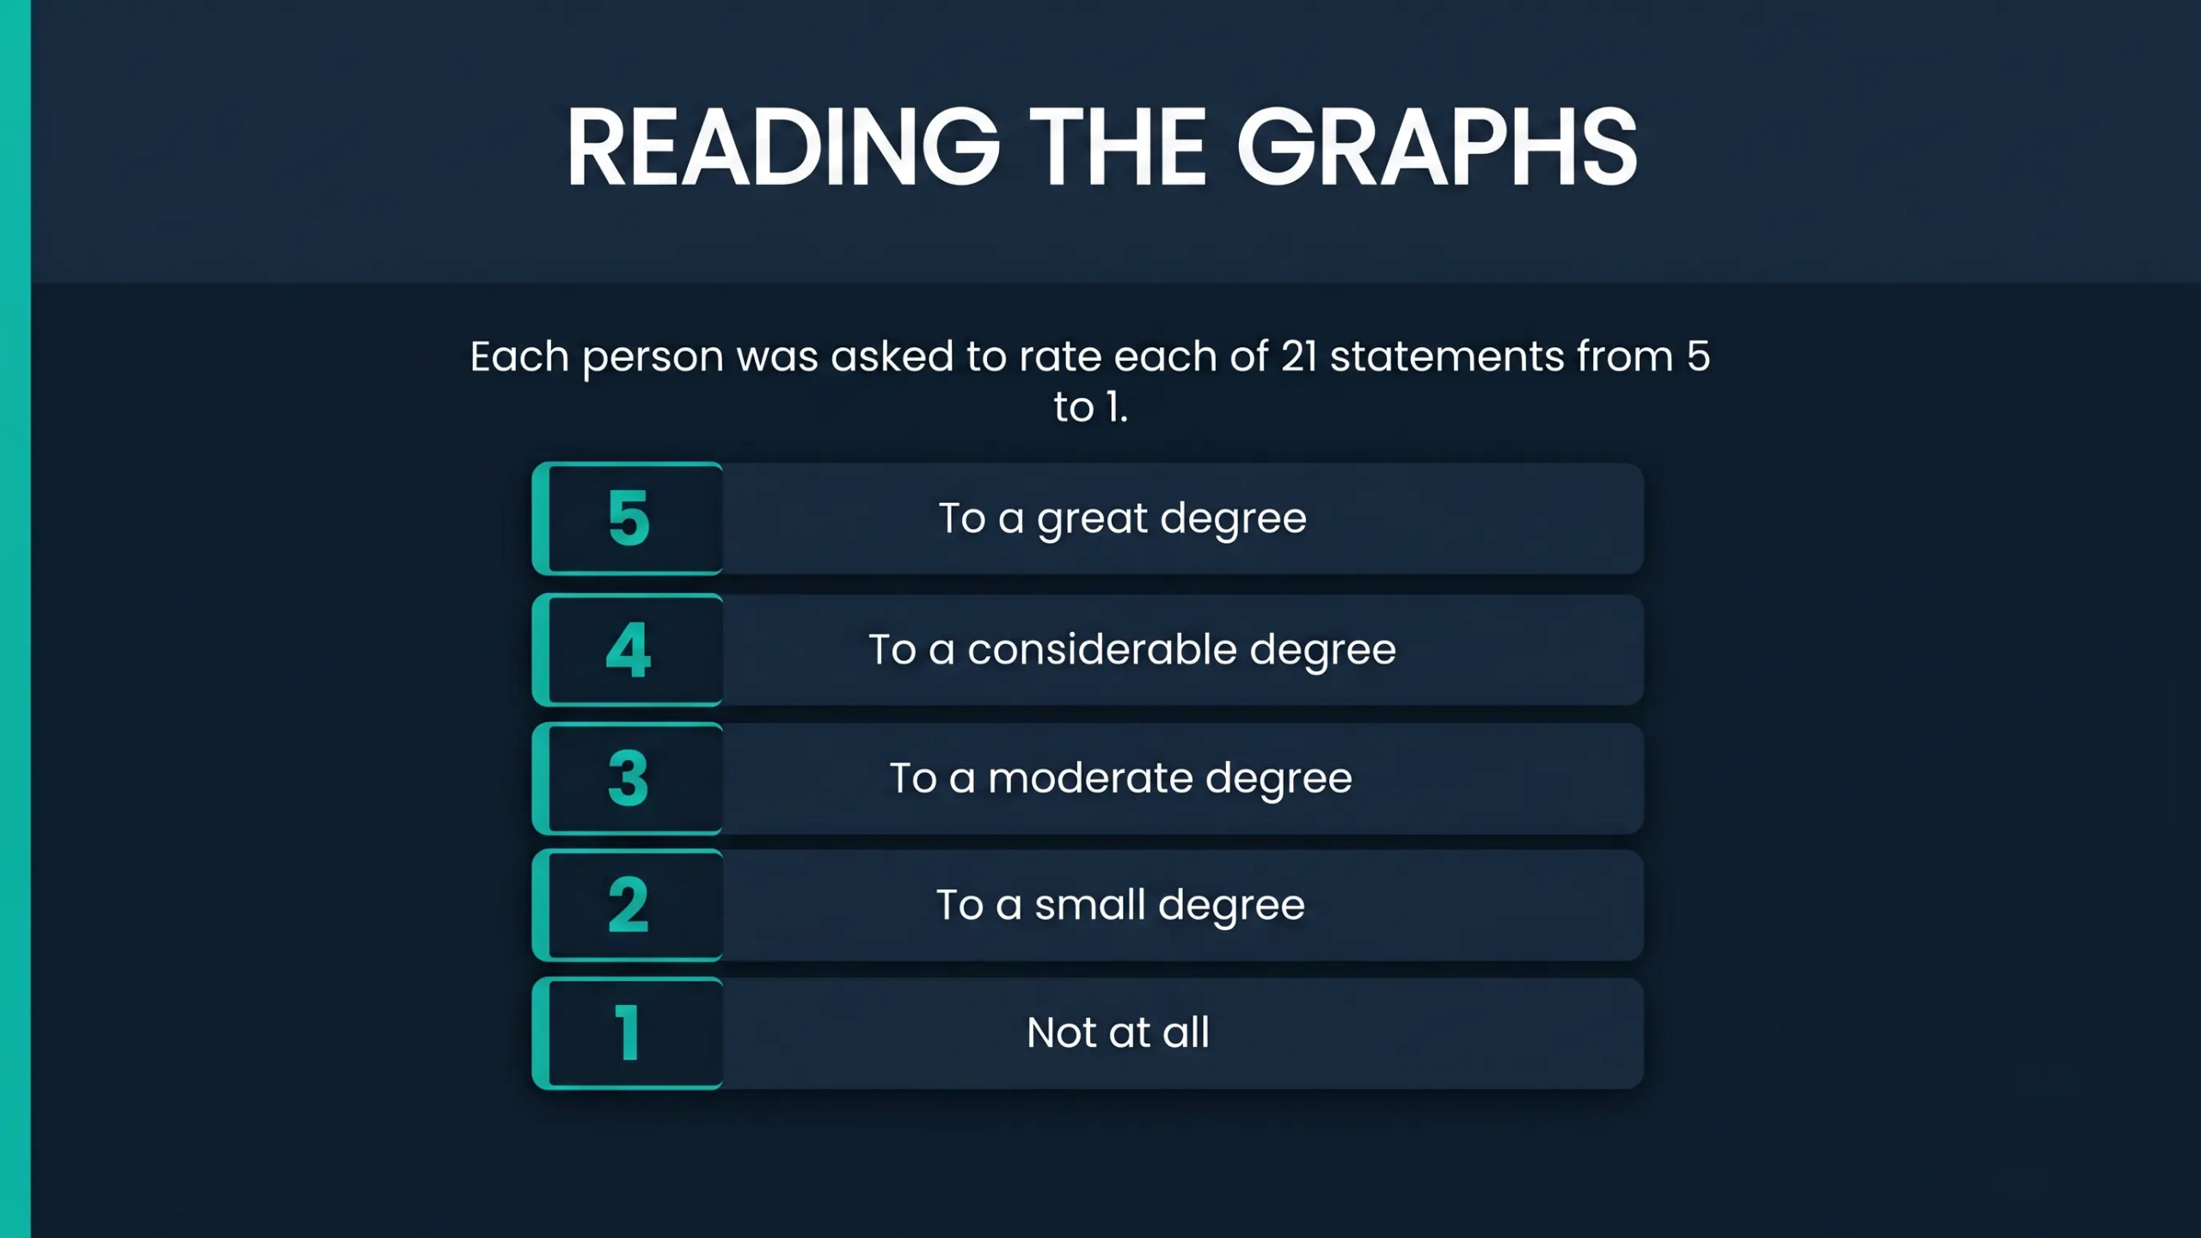
© Copyright 100-Day Advisors | MandAPlaybook.com
2

Slide 3
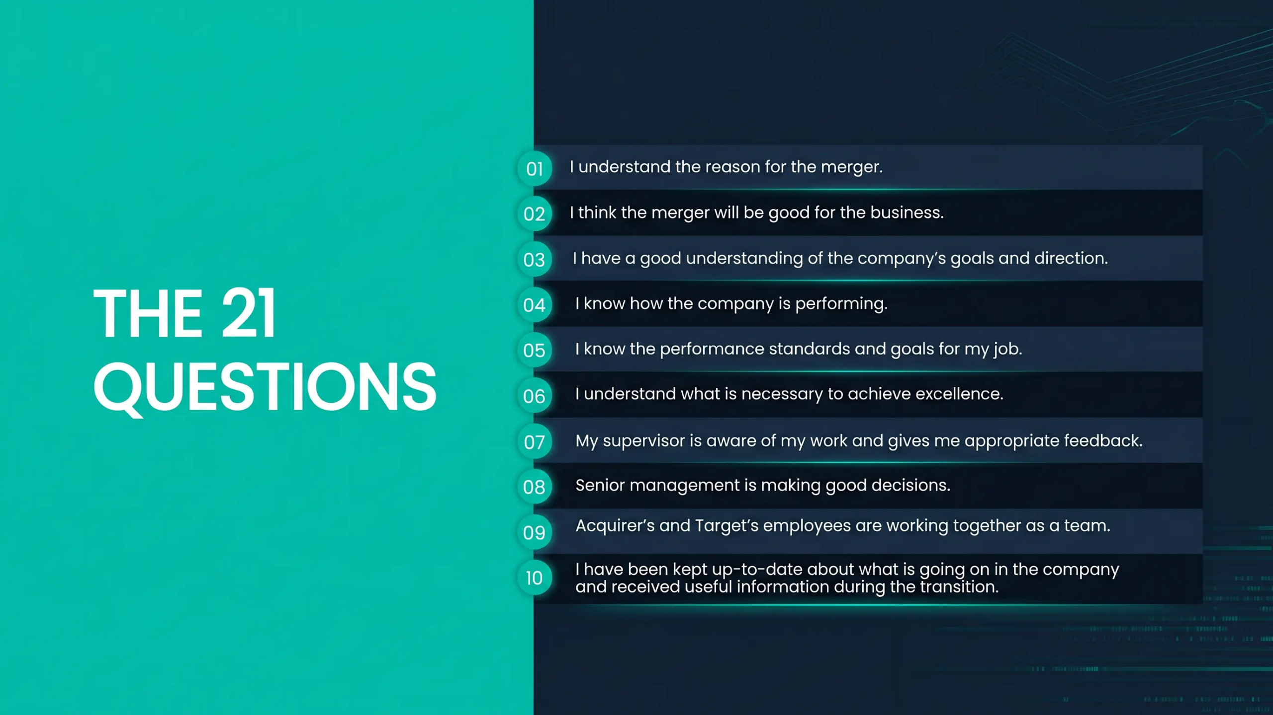
© Copyright 100-Day Advisors | MandAPlaybook.com
3

Slide 4
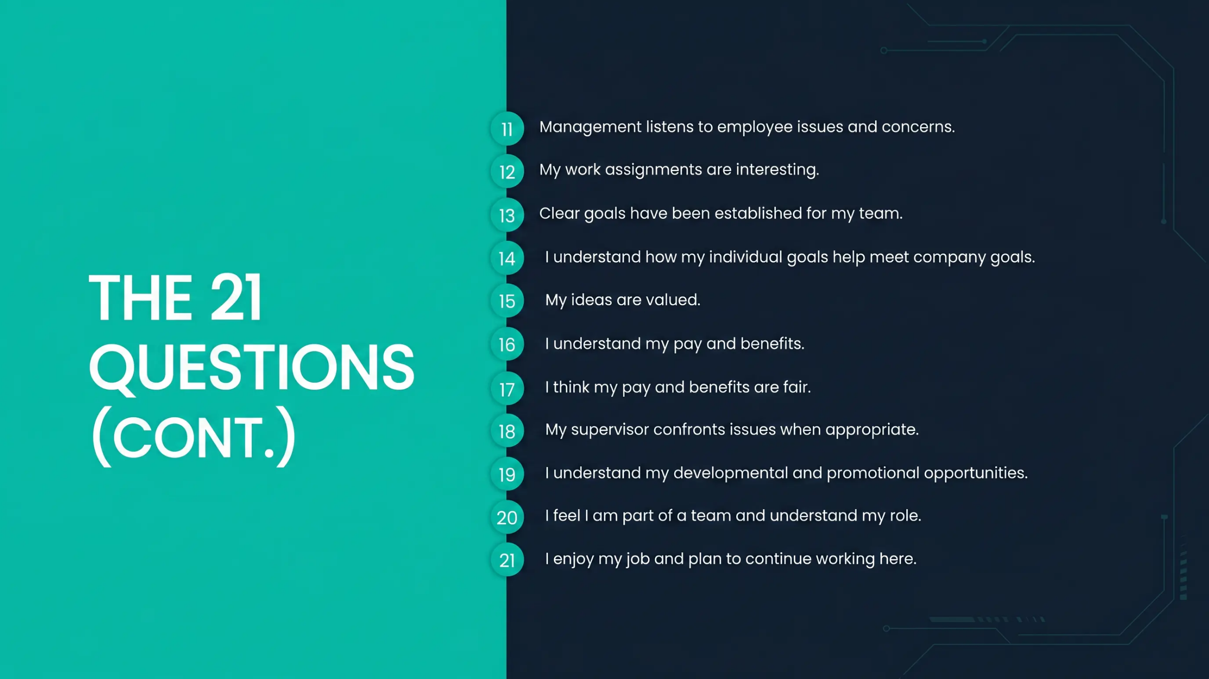
© Copyright 100-Day Advisors | MandAPlaybook.com
4

Slide 5
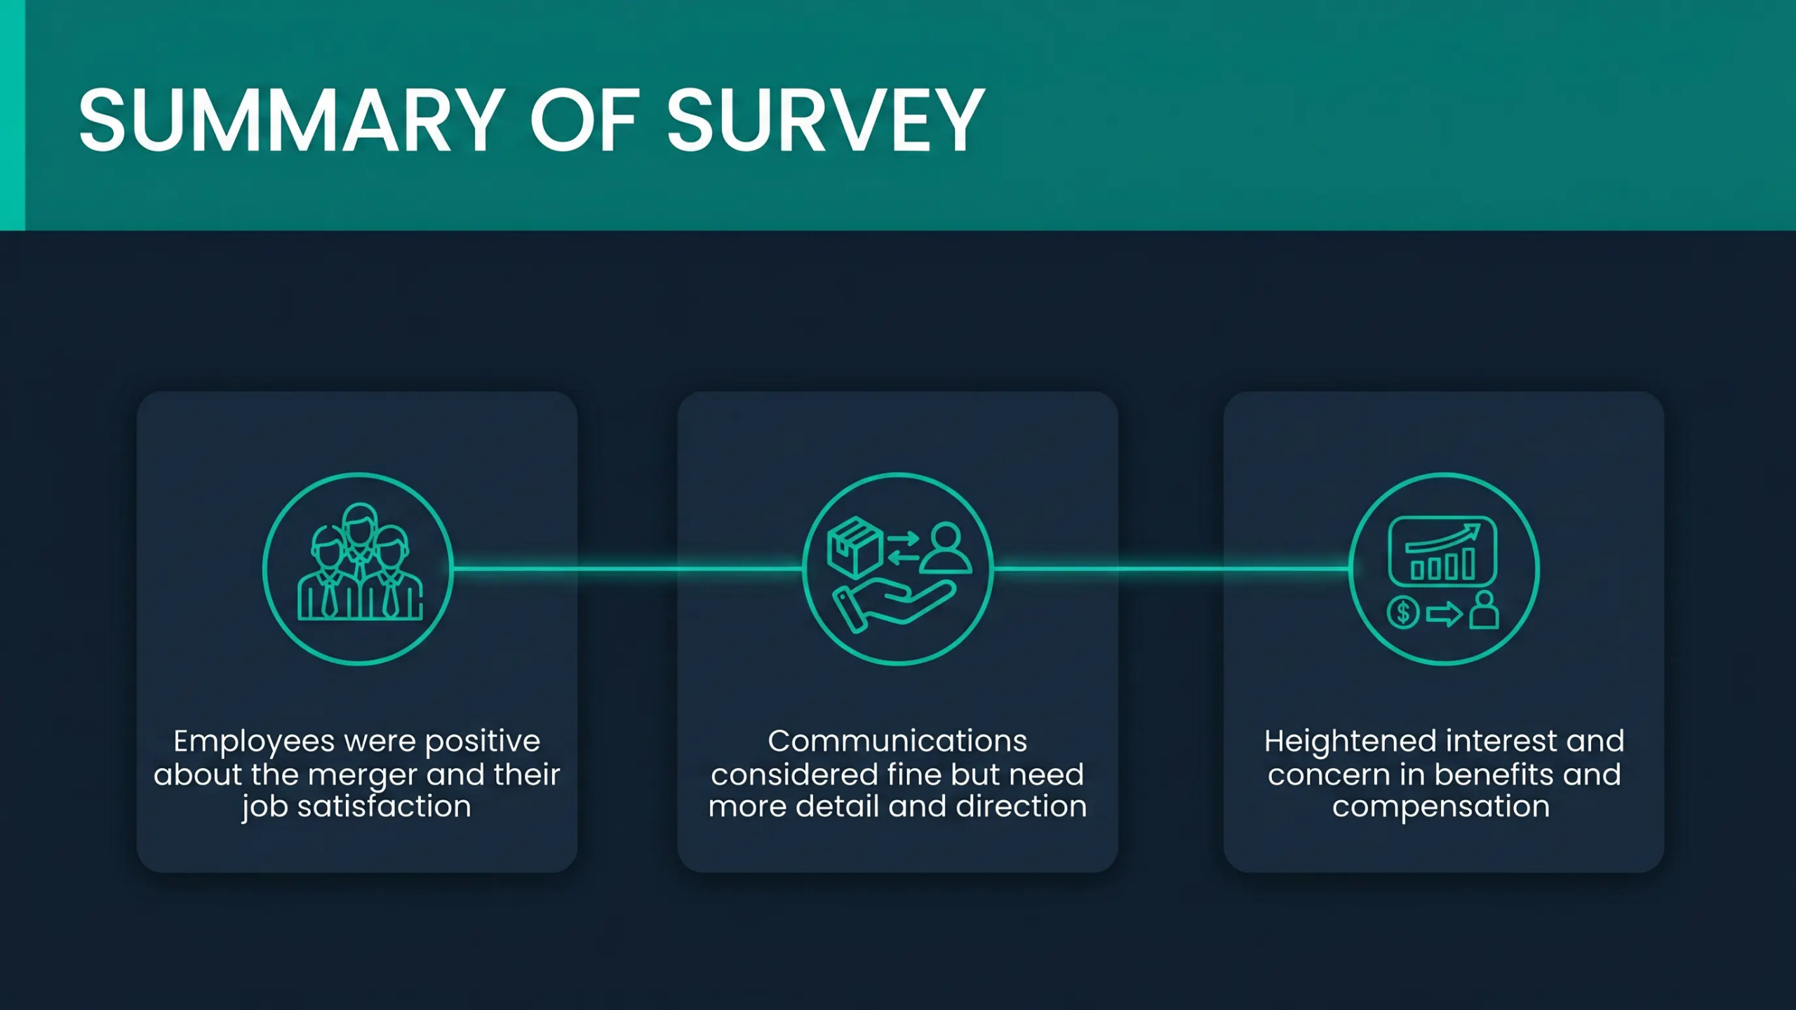
© Copyright 100-Day Advisors | MandAPlaybook.com
5

Slide 6
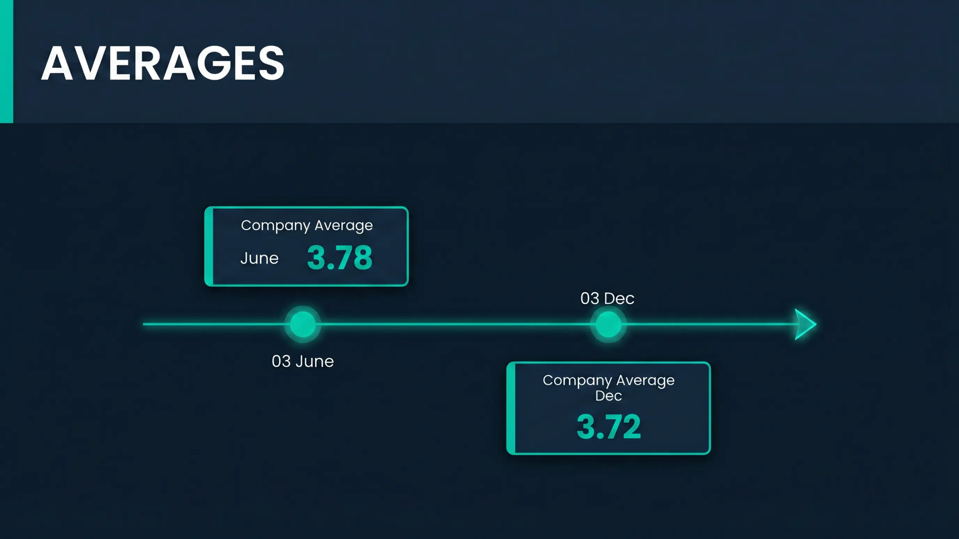
© Copyright 100-Day Advisors | MandAPlaybook.com
6

Slide 7
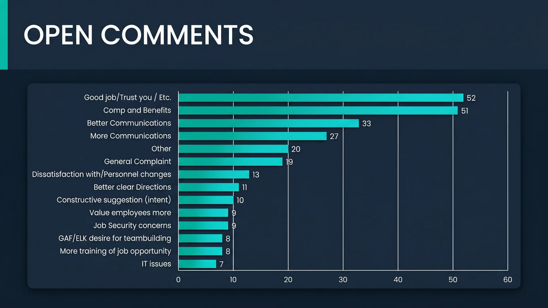
© Copyright 100-Day Advisors | MandAPlaybook.com
7

Slide 8

© Copyright 100-Day Advisors | MandAPlaybook.com
8

Slide 9
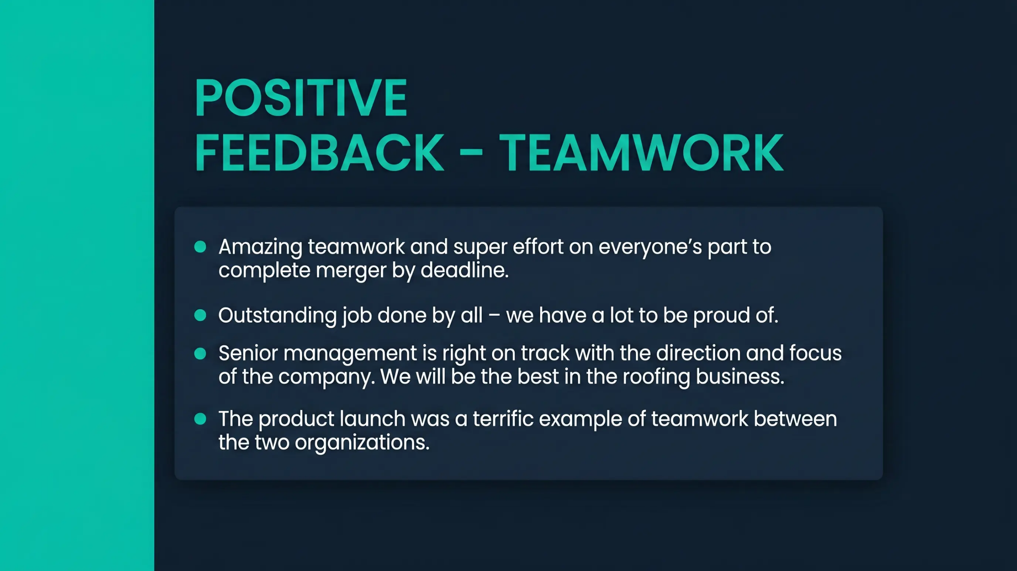
© Copyright 100-Day Advisors | MandAPlaybook.com
9

Slide 10
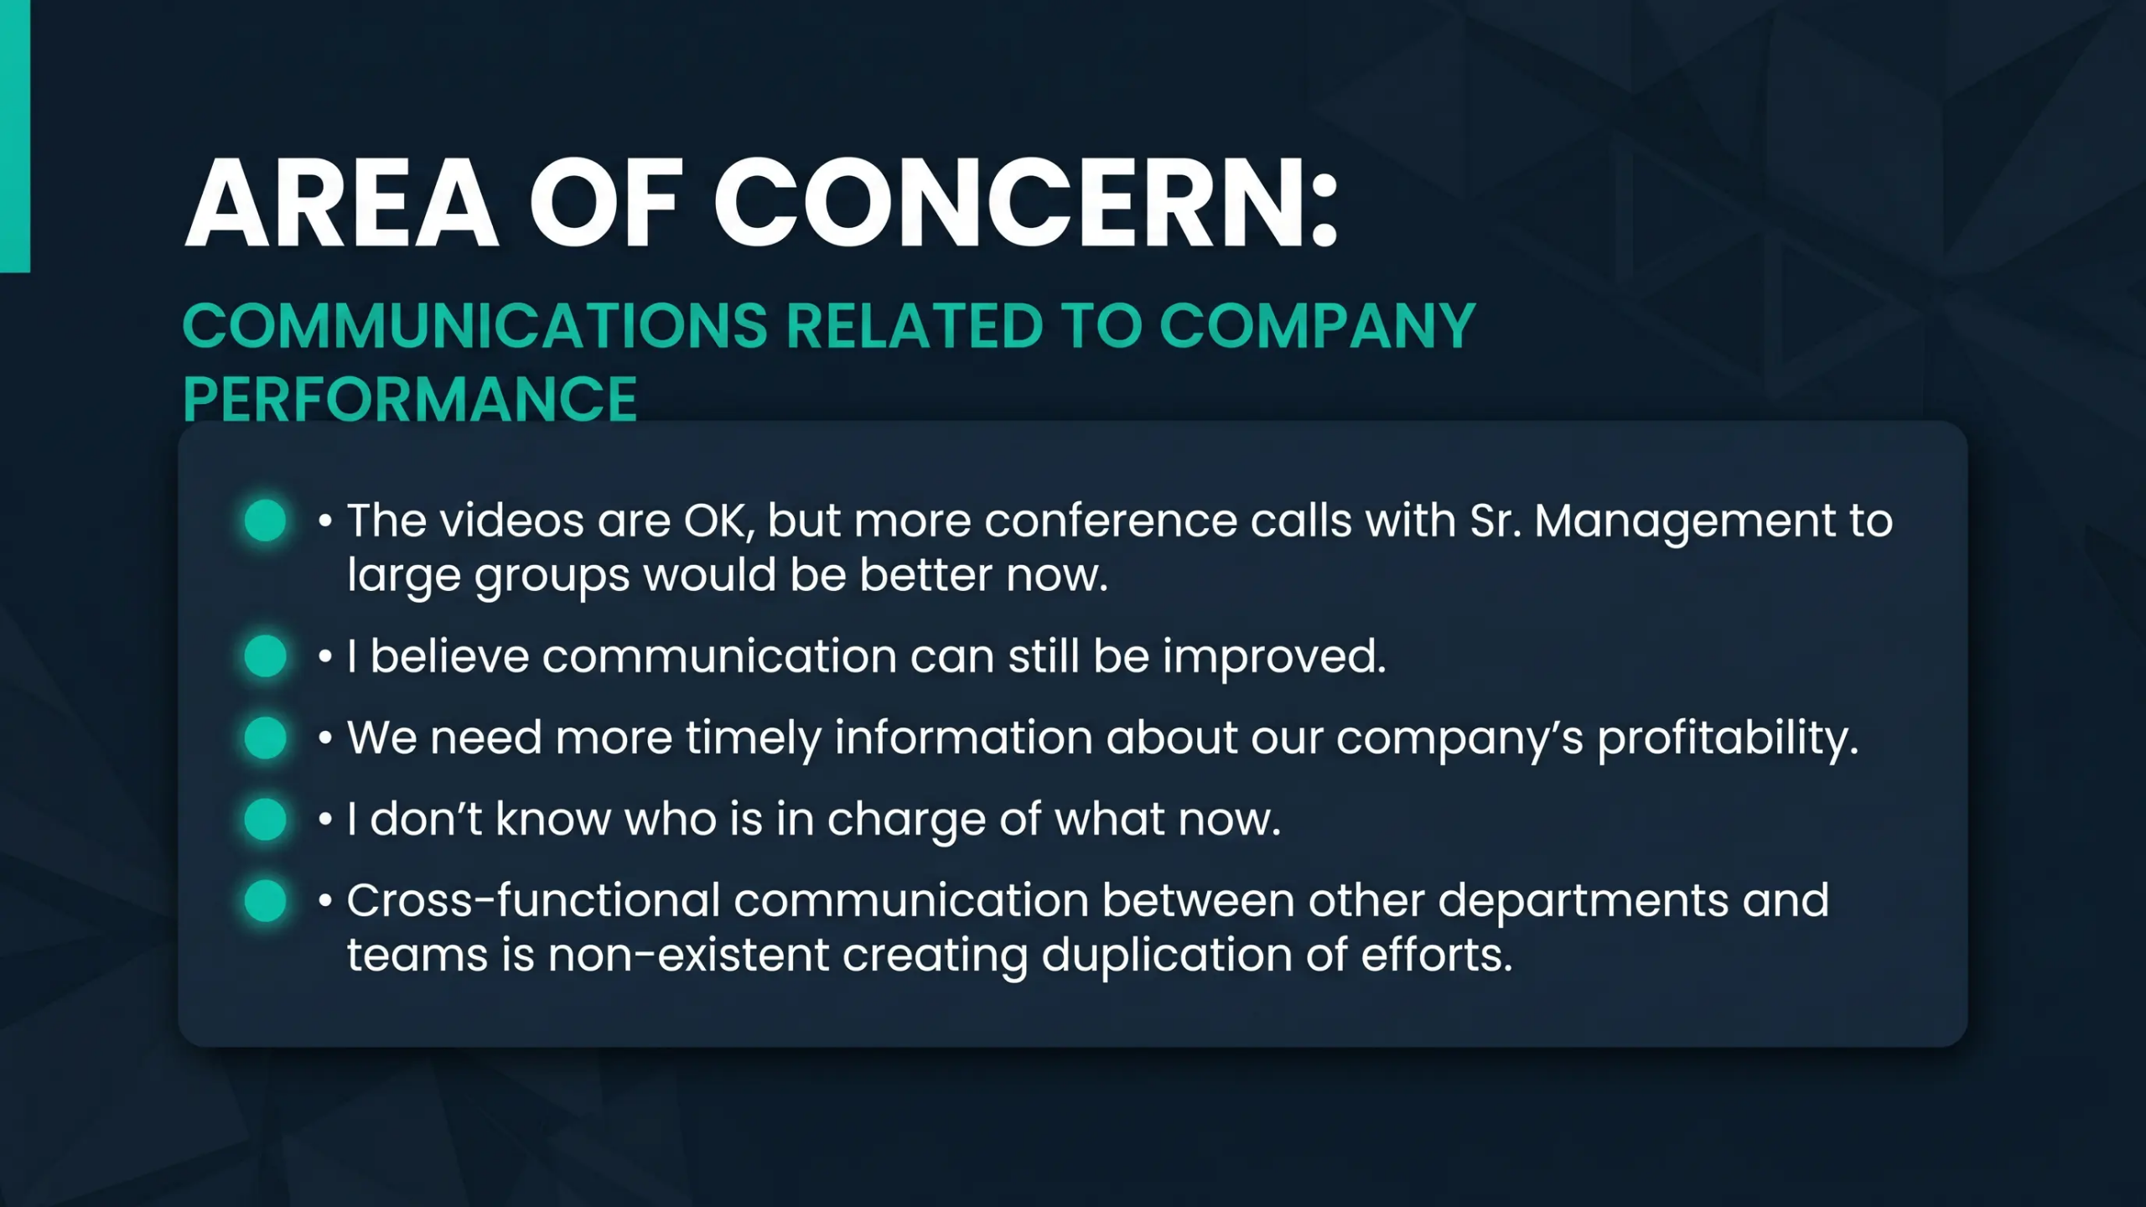
© Copyright 100-Day Advisors | MandAPlaybook.com
10

Slide 11
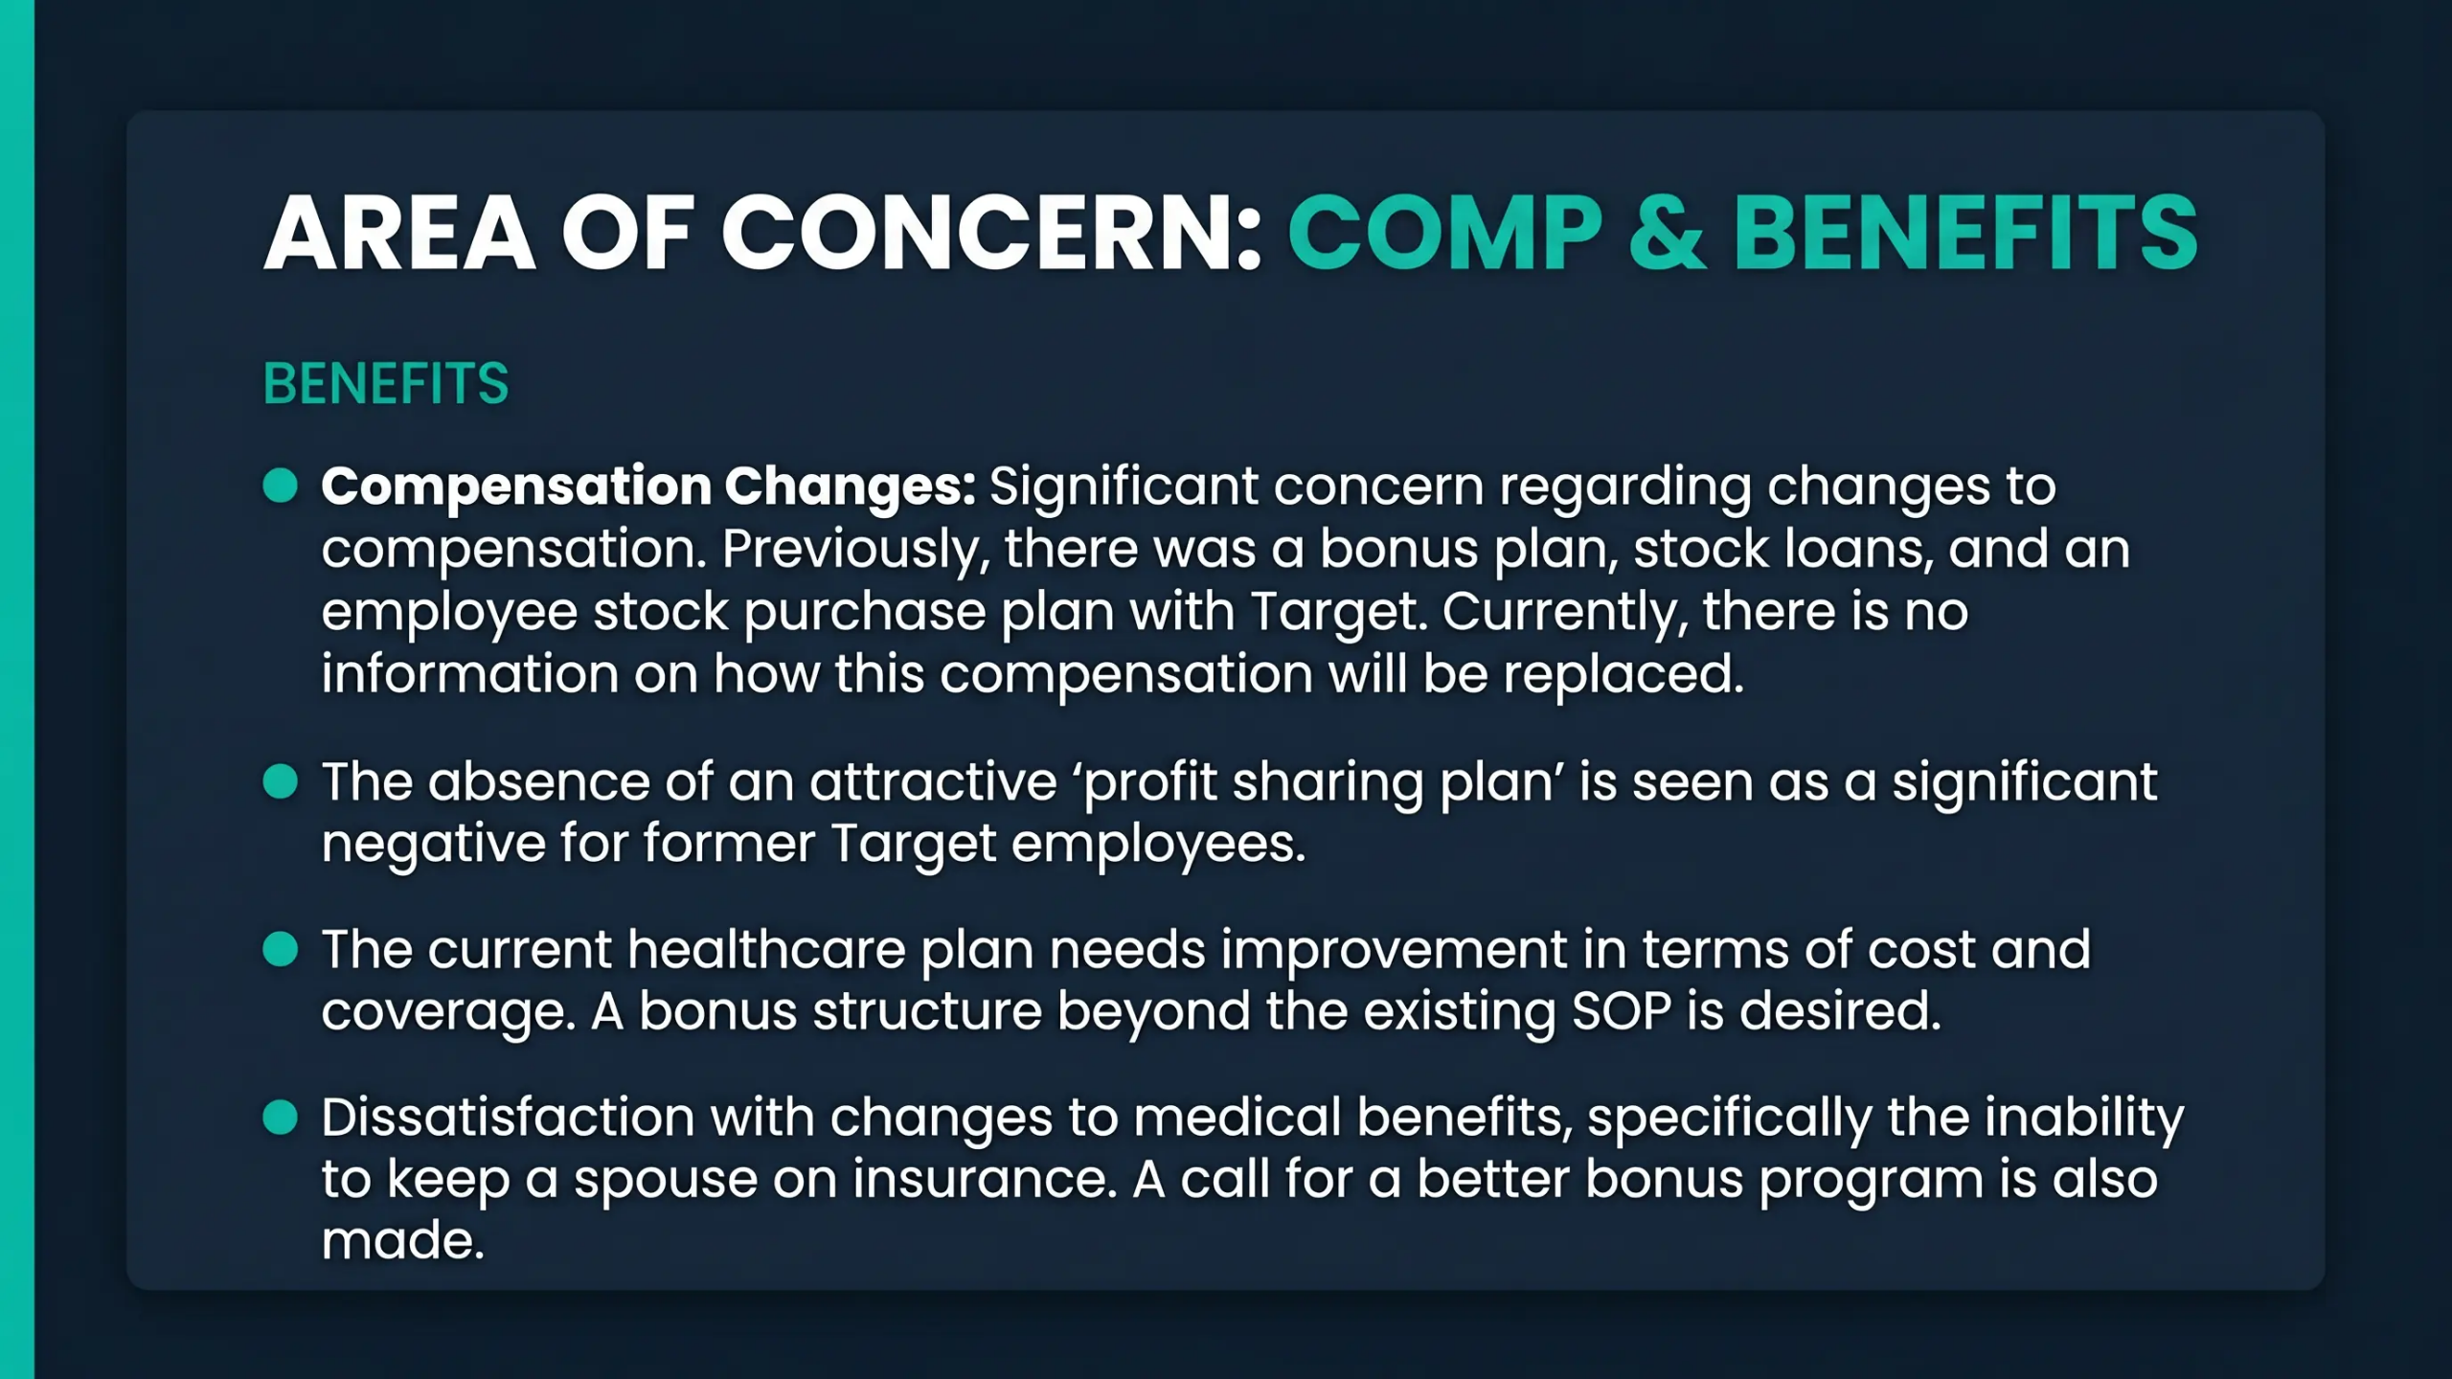
© Copyright 100-Day Advisors | MandAPlaybook.com
11

Slide 12
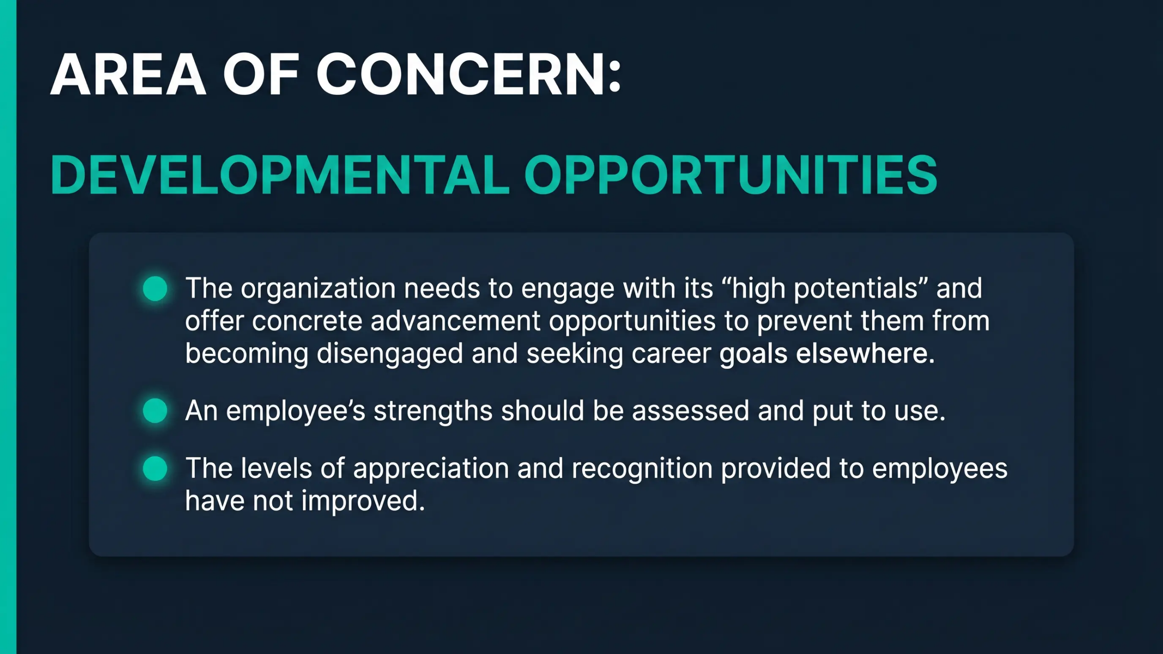
© Copyright 100-Day Advisors | MandAPlaybook.com
12

Slide 13
100-DAY ADVISORS
Accelerating M&A Integrations
MandAPlaybook.com
inquiries@MandAPlaybook.com
13

